Slide 1
C++ STL 1

Slide 2
Things to discuss...
Why use STL?
Vectors
Pairs
Stack
Queue
Dequeue

Slide 3
Why use STL
Don’t reinvent the wheel
Saves time
Avoids Error

Slide 4
Vectors
Resizable Arrays.
Comes with useful prebuilt functions such as, size(), front(), back(), etc.
They use the concept of iterators.
We can use inbuilt functions such as sort(), upper_bound(), lower_bound(), reverse, etc.
Can be of multidimensions: 1D, 2D, …
Syntax:
1D:
vector<datatype> name (size, default_value);
https://codeforces.com/group/c3FDl9EUi9/contest/262795/problem/I
2D:
vector<vector<datatype>> name(size, default_value);
https://codeforces.com/group/c3FDl9EUi9/contest/262795/problem/J

Slide 5
Pairs!
Used when we want to work with two entities simultaneously.
We can bind similar as well as different datatypes together.
Syntax:
pair<datatype, datatype>
We access the elements using the keyword first and second.
We can apply the inbuilt sort function on a container of pairs
Example :
Imagine we are given the name and marks of students of a class, and are asked to sort the students according to the marks.
If we keep the data stored in two different containers, it would be troublesome in sorting as well as maintaining the data constant for a particular student.
But if we bind the data, i.e. marks and name together, and sort according to the marks, we wouldn’t have to deal with such complicacies.
Each pair will have the following blueprint:
pair<int, string> student;
https://codeforces.com/group/c3FDl9EUi9/contest/262795/problem/K

Slide 6
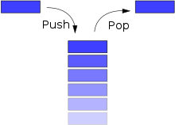
Stack
Follows Last In First Out (LIFO)
Syntax
stack<datatype> name;
Functions:
push(value)
pop()
top()
empty()
size()
clear()
These are particularly useful when you would want to convert a recursive code to iterative!
https://codeforces.com/group/c3FDl9EUi9/contest/263096/problem/D

Slide 7
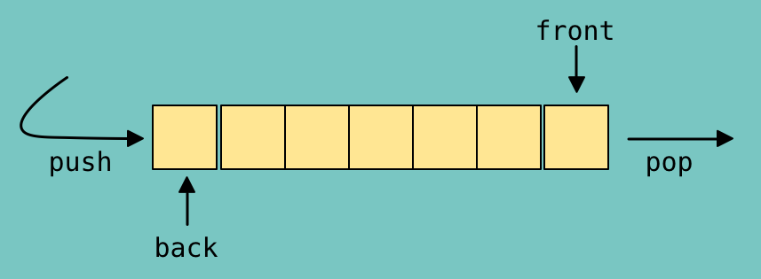
Queue
Follows Fast In First Out (FIFO)
Syntax
queue<datatype> name;
Functions:
push(value)
pop()
front()
back()
empty()
size()
clear()
These are useful in famous algorithms such as BFS, where we would want to process data in the FIFO manner. (think of a real life queue).
https://codeforces.com/group/c3FDl9EUi9/contest/263096/problem/E

Slide 8
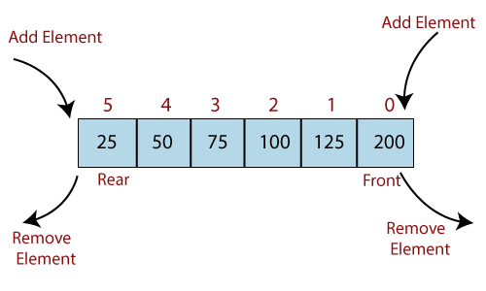
Deque
FIFO + LIFO (if this makes sense ☺)
Syntax
deque<datatype> name;
Functions:
push_back(value)
push_front(value)
pop_back()
pop_front()
front()
back()
empty()
size()
clear()
These are useful when you would like to work on subarrays or substrings (Continuous).
https://codeforces.com/group/c3FDl9EUi9/contest/263096/problem/F
PS. Look up sliding window if interested.

Slide 9
Thank You!

